Slide 1
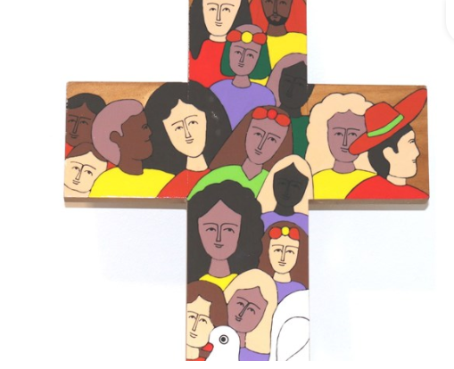
If you have a concern,
you can contact
The minister of this church:
Name and contact number
Circuit Safeguarding Officer:
Name and contact number
District Safeguarding Officer, Jane Gay:
07787 225230
east.safeguarding@gmail.com
The Methodist Church
East Anglia District
Do you feel unsafe? Are you being hurt? Do you need advice about an urgent situation?
Emergency Services 999/101
Cambridgeshire:
0345 045 1362
Norfolk: 0344 800 8020
Suffolk:
0808 800 4005
Childline: 0800 1111
If you have a concern, you can contact
The minister of this church:
Circuit Safeguarding Officer:
District Safeguarding Officer, Jane Gay:
07787 225230
east.safeguarding@gmail.com
The Safeguarding Officer for this church is:
Notes:
Jane

